Slide 1

AI Engineer Agentic Track
The Complete
Agent & MCP
Course
Week 6
Day 2

Slide 2
Week 6: MCP
Agentic
Architecture
and MCP
Building
MCP Server
Context
Engineering
with MCP
Project 8: AI
Equity Traders
Project 8: AI
Equity Traders
In Action
Week 5: Agent Frameworks
Google ADK
and A2A
Strands and
Pydantic AI
MAF and
Agno
Mastra
Project 7:
Agent Loop
Week 4: LangGraph
LangChain
Core
LangGraph
LangChain
create_agent
Deep Agents
Project 6:
Sidekick
Week 3: CrewAI
Understand
Crew AI
Concepts
Build a Crew
Agent
Project 4: Stock
Picker
Project 5:
Developer
Agent
Project 5:
Engineering
Team
Week 2: OpenAI Agents SDK
Understand
OpenAI Agents
SDK concepts
Project 2: an
SDR
Tools vs Agents
Guardrails
Project 3: Deep
Research
Project 3: Deep
Research app
Week 1: Foundations
Make an
Agentic
Workflow
Agents and
Agentic
Patterns
Orchestrating
LLMs
Autonomy and
Tools
Project 1:
Your personal
career agent

Slide 3

Today we make our own!

Slide 4
MCP Core Concepts
The Three Components:
Host is an LLM app like Claude or our Agentic Platform
MCP Client lives inside Host and connects 1:1 to MCP Server
MCP Server provides tools, context and prompts
Example:
Fetch is an MCP Server that gets a webpage and returns Markdown
You can configure Claude Desktop (the host) to run an MCP Client that then
launches the Fetch MCP Server on your computer
Agent Frameworks take care of creating the MCP Client for you - you tell it which server to attach to

Slide 5
Architecture
Your computer
Remote server
Host
MCP
Client
MCP
Client
MCP
Client
MCP
Server
MCP
Server
MCP
Server
1. List Tools 2. Call Tool

Slide 6
Architecture
Your computer
Remote server
Host
MCP
Client
MCP
Client
MCP
Client
MCP
Server
Remote server
MCP
Server
MCP
Server
API
1. List Tools 2. Call Tool

Slide 7
MCP Servers most often run on your box
Download open-source MCP Servers, run them locally
Your computer
Remote server
Host
MCP
Client
MCP
Client
MCP
Client
MCP
Server
Remote server
MCP
Server
MCP
Server
API
1. List Tools 2. Call Tool

Slide 8
Two "Transport" mechanisms
Stdio spawns a process and communicates via standard input/output
Your computer
Remote server
Host
MCP
Client
MCP
Client
MCP
Client
MCP
Server
Stdio
Stdio
Remote server
MCP
Server
MCP
Server
API
1. List Tools 2. Call Tool

Slide 9
Two "Transport" mechanisms
..while Streamable HTTP uses HTTP (replaces the older SSE)
Your computer
Remote server
Host
Streamable HTTP
MCP
Client
MCP
Client
MCP
Client
MCP
Server
Stdio
Stdio
Remote server
MCP
Server
MCP
Server
API
1. List Tools 2. Call Tool

Slide 10
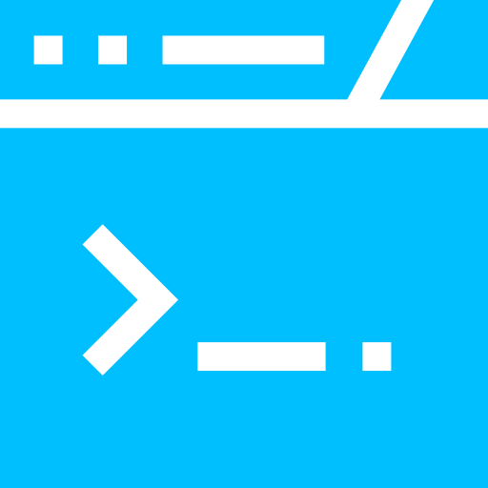

Connecting to MCP servers
A server is just a set of parameters
STDIO a local process to spawn
fetch
{"command": "uvx", "args": ["mcp-server-fetch"]}
playwright
{"command": "npx", "args": ["@playwright/mcp@latest"]}
Streamable HTTP a remote URL
context7
{"url": "https://mcp.context7.com/mcp", "timeout": 60}

Slide 11
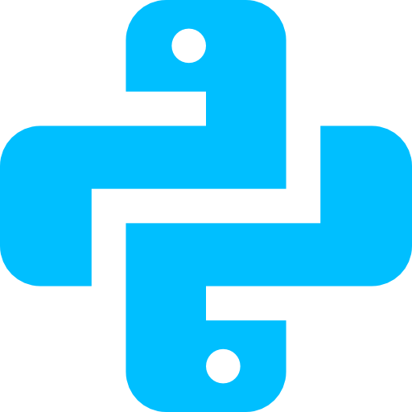
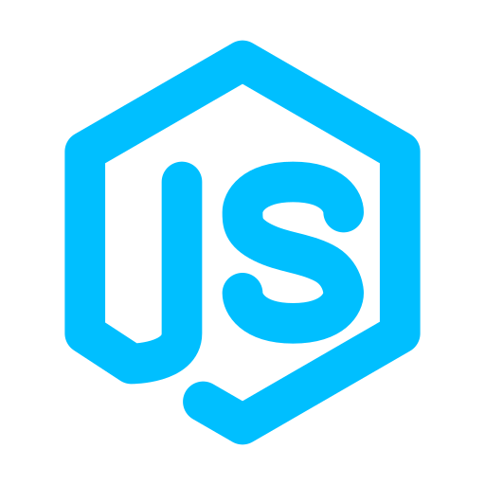
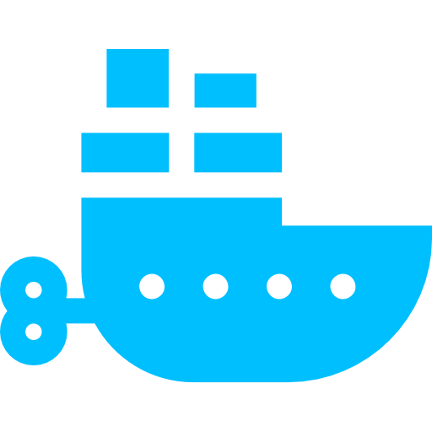
Spawning a local server
The command tells the client how to launch it
uvx for Python MCP servers
npx for Node and JavaScript servers
docker for servers packaged as a container

Slide 12
Making an MCP Server
Why make an MCP Server
Allow others to incorporate tools
Consistently incorporate all our MCP Servers
Understand the plumbing
Reasons not to make an MCP Server
If it's only for us, then we could just make tools -
the @function_tool decorator can make any function
into a tool

Slide 13
Week 6: MCP
Agentic
Architecture
and MCP
Building
MCP Server
Context
Engineering
with MCP
Project 8: AI
Equity Traders
Project 8: AI
Equity Traders
In Action
Week 5: Agent Frameworks
Google ADK
and A2A
Strands and
Pydantic AI
MAF and
Agno
Mastra
Project 7:
Agent Loop
Week 4: LangGraph
LangChain
Core
LangGraph
LangChain
create_agent
Deep Agents
Project 6:
Sidekick
Week 3: CrewAI
Understand
Crew AI
Concepts
Build a Crew
Agent
Project 4: Stock
Picker
Project 5:
Developer
Agent
Project 5:
Engineering
Team
Week 2: OpenAI Agents SDK
Understand
OpenAI Agents
SDK concepts
Project 2: an
SDR
Tools vs Agents
Guardrails
Project 3: Deep
Research
Project 3: Deep
Research app
Week 1: Foundations
Make an
Agentic
Workflow
Agents and
Agentic
Patterns
Orchestrating
LLMs
Autonomy and
Tools
Project 1:
Your personal
career agent

Slide 14

AI Engineer Agentic Track
The Complete
Agent & MCP
Course
90%
Complete

